Slide 1
Data Analytics – Lesson 18 Cluster Models using R
Jeffrey Strickland, Ph.D., CMSP, ASEP
CEO Humalytica Analytics

Slide 2
Cluster Models
According to Vladimir Estivill-Castro, the notion of a “cluster” cannot be precisely defined, which is one of the reasons why there are so many clustering algorithms (Estivill-Castro, 2002).
There is a common denominator: a group of data objects.
However, different researchers employ different cluster models, and for each of these cluster models again different algorithms can be given.
The notion of a cluster, as found by different algorithms, varies significantly in its properties.
Understanding these “cluster models” is key to understanding the differences between the various algorithms.

Slide 3
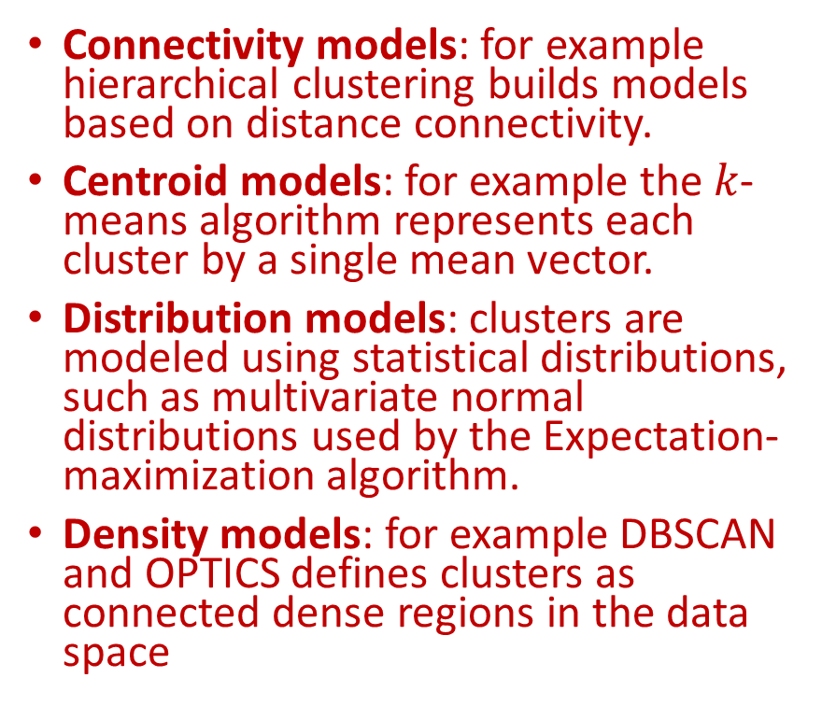
Typical cluster models
Connectivity models: for example hierarchical clustering builds models based on distance connectivity.
Centroid models: for example the $k$-means algorithm represents each cluster by a single mean vector.
Distribution models: clusters are modeled using statistical distributions, such as multivariate normal distributions used by the Expectation-maximization algorithm.
Density models: for example DBSCAN and OPTICS defines clusters as connected dense regions in the data space
Subspace models: in Biclustering (also known as Co-clustering or two-mode-clustering), clusters are modeled with both cluster members and relevant attributes.
Group models: some algorithms do not provide a refined model for their results and just provide the grouping information.
Graph-based models: a clique, i.e., a subset of nodes in a graph such that every two nodes in the subset are connected by an edge can be considered as a prototypical form of cluster. Relaxations of the complete connectivity requirement (a fraction of the edges can be missing) are known as quasi-cliques.

Slide 4
A Clustering
A "clustering" is essentially a set of such clusters, usually containing all objects in the data set. Additionally, it may specify the relationship of the clusters to each other, for example a hierarchy of clusters embedded in each other.
Clusterings can be roughly distinguished as:
hard clustering: each object belongs to a cluster or not
soft clustering (also: fuzzy clustering): each object belongs to each cluster to a certain degree (e.g. a likelihood of belonging to the cluster)

Slide 5
Finer Distinctions
Strict partitioning clustering: here each object belongs to exactly one cluster
Strict partitioning clustering with outliers: objects can also belong to no cluster, and are considered outliers.
Overlapping clustering (also: alternative clustering, multi-view clustering): while usually a hard clustering, objects may belong to more than one cluster.
Hierarchical clustering: objects that belong to a child cluster also belong to the parent cluster
Subspace clustering: while an overlapping clustering, within a uniquely defined subspace, clusters are not expected to overlap.

Slide 6

Connectivity based clustering (hierarchical clustering)
At different distances, different clusters will form, which can be represented using a
A dendrogram explains where the common name “hierarchical clustering” comes from:
these algorithms do not provide a single partitioning of the data set
instead provide an extensive hierarchy of clusters that merge with each other at certain distances.
In a dendrogram, the $y$-axis marks the distance at which the clusters merge, while the objects are placed along the $x$-axis such that the clusters don’t mix.
Connectivity based clustering, also known as hierarchical clustering, is based on the core idea of objects being more related to nearby objects than to objects farther away.
These algorithms connect “objects” to form "clusters" based on their distance.
A cluster can be described largely by the maximum distance needed to connect parts of the cluster.

Slide 7
Strategies for hierarchical clustering
Agglomerative: This is a "bottom up" approach: each observation starts in its own cluster, and pairs of clusters are merged as one moves up the hierarchy.
Divisive: This is a "top down" approach: all observations start in one cluster, and splits are performed recursively as one moves down the hierarchy.

Slide 8
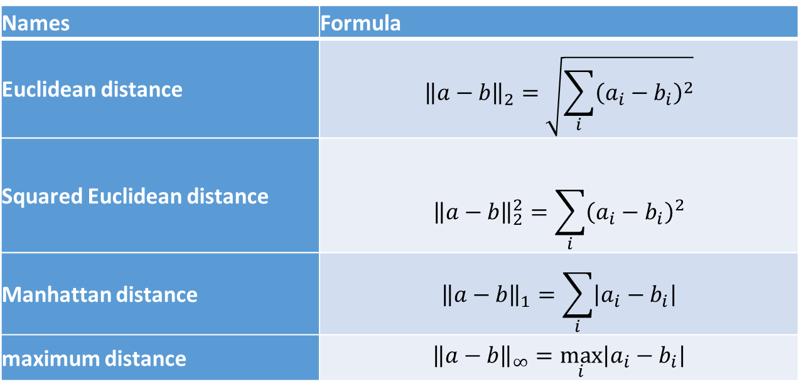
Metrics
Names | Formula
Euclidean distance | $${\left\|a−b\right\|}_{2}=\sqrt{\sum_{i}{{\left(a_{i}−b_{i}\right)}^{2}}}$$
Squared Euclidean distance | $${\left\|a−b\right\|}_{2}^{2}=\sum_{i}{{\left(a_{i}−b_{i}\right)}^{2}}$$
Manhattan distance | $${\left\|a−b\right\|}_{1}=\sum_{i}{\left|a_{i}−b_{i}\right|}$$
maximum distance | $${\left\|a−b\right\|}_{∞}=\max_{i}\left|a_{i}−b_{i}\right|$$

Slide 9
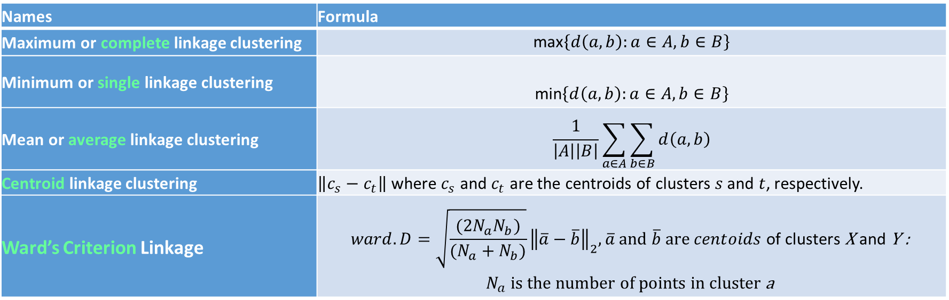
Linkage criteria
The linkage criterion determines the distance between sets of observations as a function of the pairwise distances between observations.
Names | Formula
Maximum or complete linkage clustering | $$\text{max}\left\{d\left(a,b\right):a∈A,b∈B\right\}$$
Minimum or single linkage clustering | $$\text{min}\left\{d\left(a,b\right):a∈A,b∈B\right\}$$
Mean or average linkage clustering | $$\frac{1}{\left|A\right|\left|B\right|}\sum_{a∈A}{\sum_{b∈B}{d\left(a,b\right)}}$$
Centroid linkage clustering | $\left\|c_{s}−c_{t}\right\|$ where $c_{s}$ and $c_{t}$ are the centroids of clusters $s$ and $t$, respectively.
Ward’s Criterion Linkage | $$ward.D=\sqrt{\frac{{(2N}_{a}N_{b})}{(N_{a}+N_{b})}}{\left\|\overline{a}−\overline{b}\right\|}_{2}, \overline{a} and \overline{b} are centoids \text{of} \text{clusters} \text{X} \text{and} \text{Y}\text{ :}$$ $$N_{a} \text{is} \text{the} \text{number} \text{of} \text{points} \text{in} \text{cluster} \text{a}$$

Slide 10
Other linkage criteria
The sum of all intra-cluster variance.
The decrease in variance for the cluster being merged (Ward's criterion) (Ward, 1963).
The probability that candidate clusters spawn from the same distribution function (V-linkage).
The product of in-degree and out-degree on a k-nearest-neighbor graph (graph degree linkage) (Zhang e. a., October 7–13, 2012).
The increment of some cluster descriptor (i.e., a quantity defined for measuring the quality of a cluster) after merging two clusters (Zhang e. a., Agglomerative clustering via maximum incremental path integral, 2013).

Slide 11
Analyzing Votes with Clustering
The ‘cluster’ package provides several useful functions for clustering analysis. We will use one here called ‘agnes’, which performs agglomerative hierarchical clustering of a dataset.
The dataset we will use, ‘votes.repub’ is included in the package.
A data frame with the percents of votes given to the republican candidate in presidential elections from 1856 to 1976. Rows represent the 50 states, and columns the 31 elections.

Slide 12
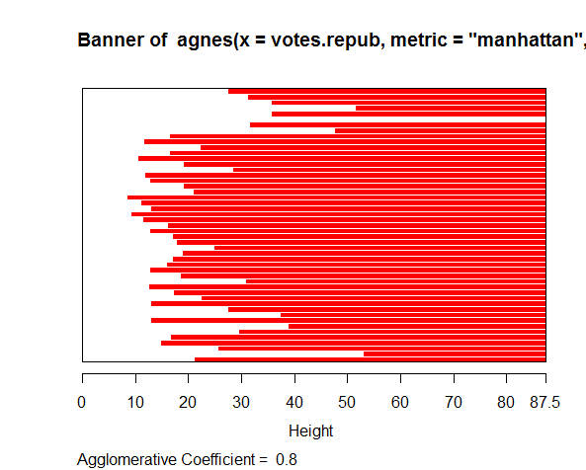
Analyzing Votes with Clustering
library(cluster)
data(votes.repub)
agn1 <- agnes(votes.repub, metric = "manhattan", stand = TRUE)
agn1
plot(agn1)

Slide 13
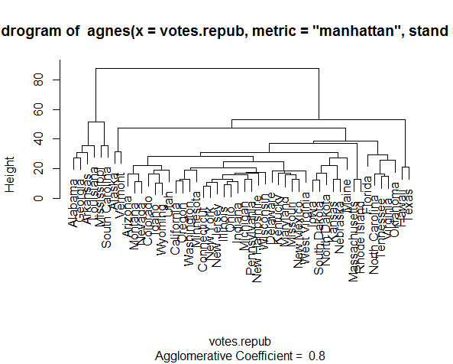
Analyzing Votes with Clustering
op <- par(mfrow=c(2,2))
agn2 <- agnes(daisy(votes.repub), diss = TRUE, method = "complete")
plot(agn2)
## alpha = 0.625 ==> beta = -1/4 is "recommended" by some
agnS <- agnes(votes.repub, method = "flexible", par.meth = 0.625)
plot(agnS)

Slide 14
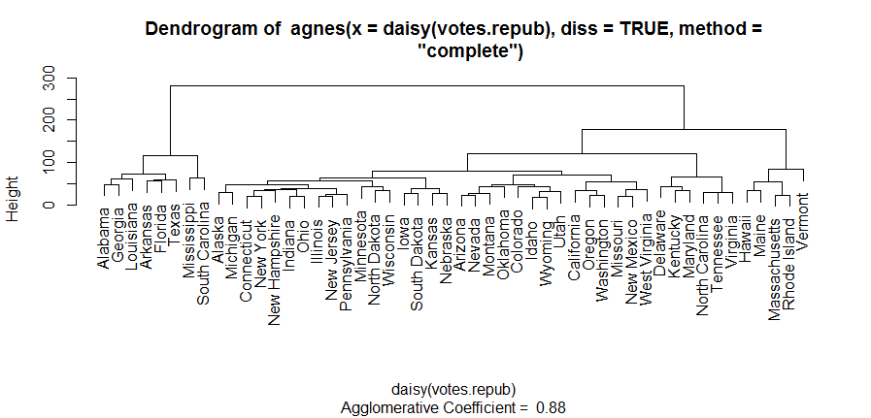
Dendrogram of agnes(vote.repub)

Slide 15
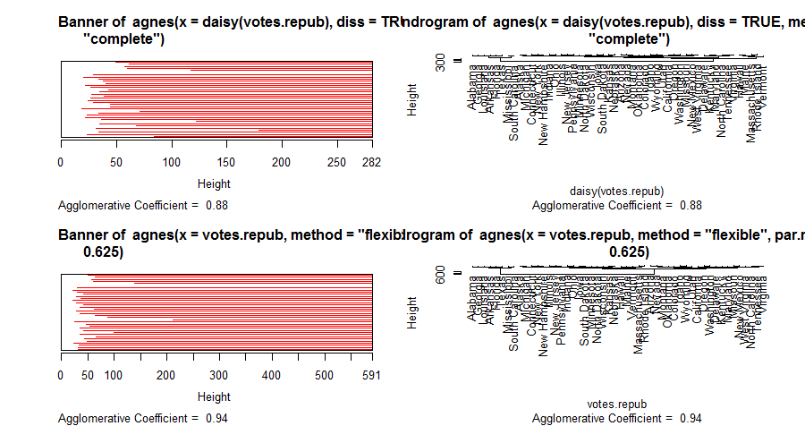
Analyzing Votes with Clustering

Slide 16
Analyzing Votes with Clustering
## "show" equivalence of three "flexible" special cases
d.vr <- daisy(votes.repub)
a.wgt <- agnes(d.vr, method = "weighted")
a.sing <- agnes(d.vr, method = "single")
a.comp <- agnes(d.vr, method = "complete")
iC <- -(6:7) # not using 'call' and 'method' for comparisons
stopifnot(all.equal(a.wgt [iC], agnes(d.vr, method="flexible",par.method = 0.5)[iC]), all.equal(a.sing[iC], agnes(d.vr, method="flex", par.method= c(.5,.5,0, -.5))[iC]), all.equal(a.comp[iC], agnes(d.vr, method="flex", par.method= c(.5,.5,0, +.5))[iC]))

Slide 17
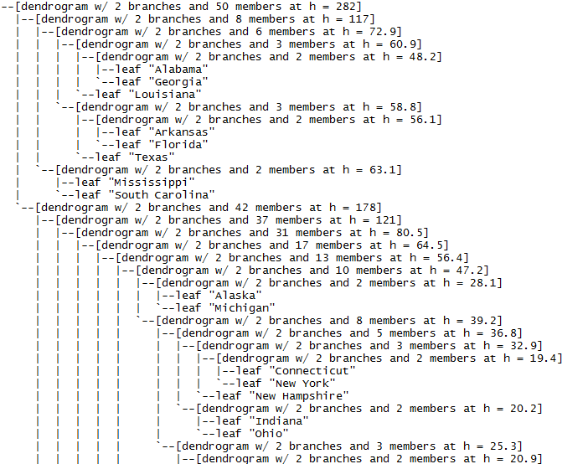
Analyzing Votes with Clustering
(d2 <- as.dendrogram(agn2)) # two main branches 'dendrogram' with 2 branches and 50 members total, at height 281.9508
d2[[1]] # the first branch 'dendrogram' with 2 branches and 8 members total, at height 116.7048
d2[[2]] # the 2nd one { 8 + 42 = 50 } 'dendrogram' with 2 branches and 42 members total, at height 178.4119
d2[[1]][[1]] # first sub-branch of branch 1 .. and shorter form 'dendrogram' with 2 branches and 6 members total, at height 72.92212
identical(d2[[c(1,1)]], d2[[1]][[1]])
# a "textual picture" of the dendrogram:
str(d2)

Slide 18
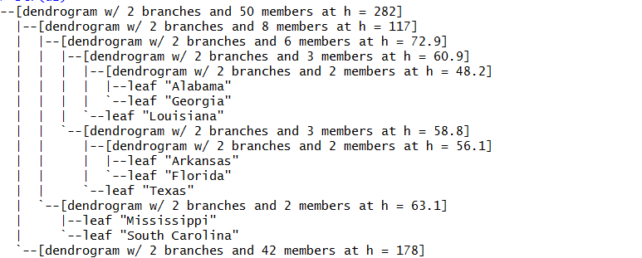
Interpret the Results
From the dendrogram we can see some logical clustering at the 0-level.
at the 40-level Georgia, Alabama, and Louisiana are grouped together.
Also, at the 50-level Georgia, Alabama, Louisiana, Arkansas, and Florida are grouped together.

Slide 19
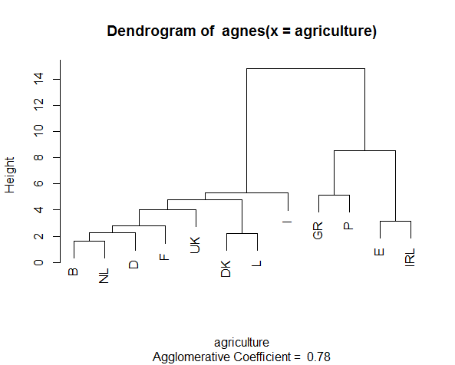
GNP - Interpret the Results
Gross National Product (GNP) per capita and percentage of the population working in agriculture for each country belonging to the European Union in 1993.
plot(agnes(agriculture), ask = TRUE)

Slide 20
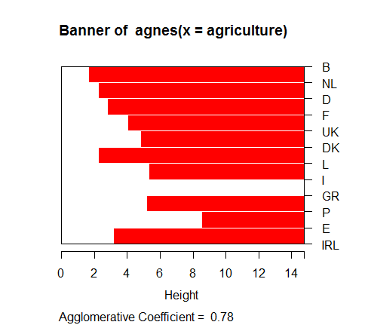
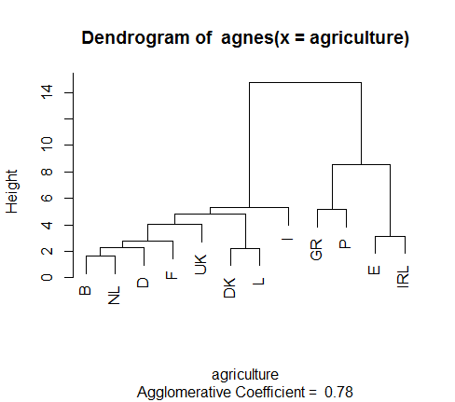
GNP – All Plots

Slide 21
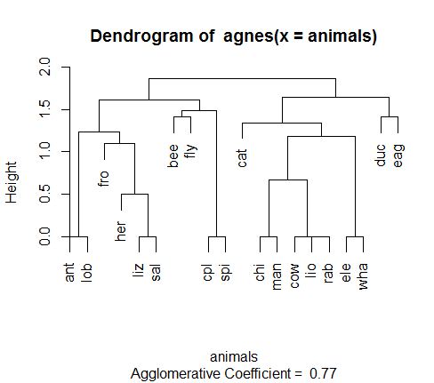
Animals - Interpret the Results
This data set considers 6 binary attributes for 20 animals.
aa.a <- agnes(animals) # default method = "average"
aa.ga <- agnes(animals, method = "gaverage")
op <- par(mfcol=1:2, mgp=c(1.5, 0.6, 0), mar=c(.1+ > c(4,3,2,1)),cex.main=0.8)
plot(aa.a, which.plot = 2)

Slide 22
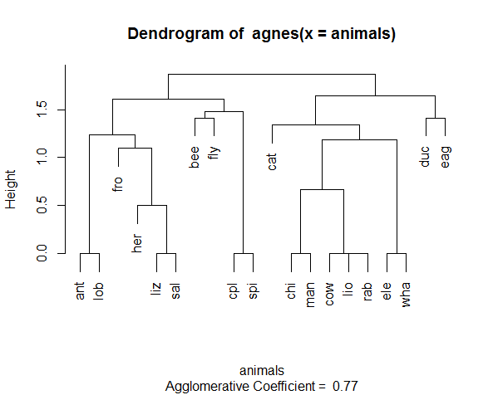
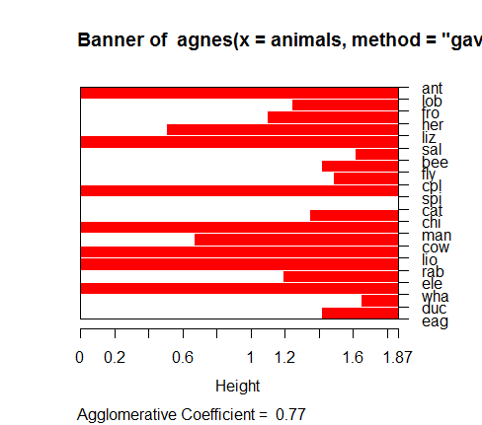
Animals - All Plots

Slide 23
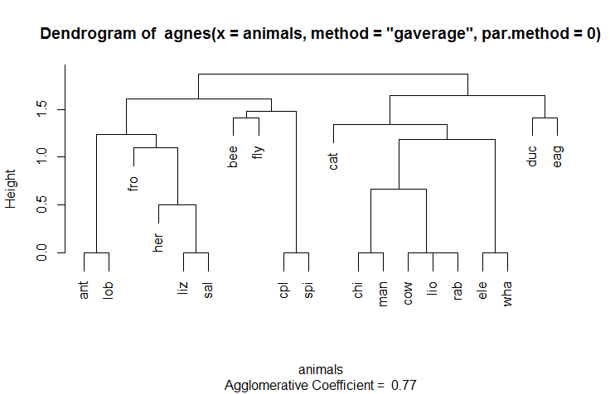
Adding a Heading

Slide 24

K-means Clustering
Unlike hierarchical clustering, $k$-means clustering requires that the number of clusters to extract be specified in advance.
The wine dataset contains the results of a chemical analysis of wines grown in a specific area of Italy. Three types of wine are represented in the 178 samples, with the results of 13 chemical analyses recorded for each sample. The Type variable has been transformed into a categoric variable.
The data contains no missing values and consits of only numeric data, with a three class target variable (Type) for classification.
The data originally come from the UCI Machine Learning Repository (http://www.ics.uci.edu/~mlearn/MLRepository.html) but we will access it via the rattle package.

Slide 25
K-Means Clustering
library(rattle)
data(wine)
head(wine)
Type Alcohol Malic Ash Alcalinity Magnesium Phenols Flavanoids
1 1 14.23 1.71 2.43 15.6 127 2.80 3.06
2 1 13.20 1.78 2.14 11.2 100 2.65 2.76
3 1 13.16 2.36 2.67 18.6 101 2.80 3.24
4 1 14.37 1.95 2.50 16.8 113 3.85 3.49
5 1 13.24 2.59 2.87 21.0 118 2.80 2.69
6 1 14.20 1.76 2.45 15.2 112 3.27 3.39
Nonflavanoids Proanthocyanins Color Hue Dilution Proline
1 0.28 2.29 5.64 1.04 3.92 1065
2 0.26 1.28 4.38 1.05 3.40 1050
3 0.30 2.81 5.68 1.03 3.17 1185
4 0.24 2.18 7.80 0.86 3.45 1480
5 0.39 1.82 4.32 1.04 2.93 735
6 0.34 1.97 6.75 1.05 2.85 1450

Slide 26
K-Means Clustering
It looks like the variables are measured on different scales, so we will likely want to standardize the data before proceeding.
The ‘scale’ function will do this.
Additionally, a plot of the total within-groups sums of squares against the number of clusters in a k-means solution can be helpful.
A bend in the graph can suggest the appropriate number of clusters. The graph can be produced by the following function.
We also use the NbClust package here.
NbClust package provides 30 indices for determining the number of clusters and proposes to user the best clustering scheme from the different results obtained by varying all combinations of number of clusters, distance measures, and clustering methods.

Slide 27
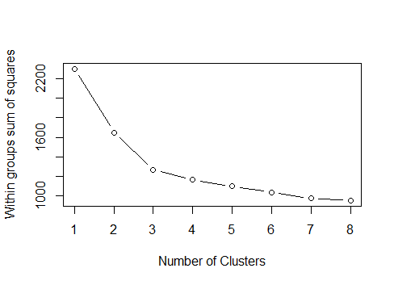
Wssplot Function – How Many Clusters?
A fundamental question is how to determine the value of the parameter k.
If we looks at the percentage of variance explained as a function of the number of clusters, one should choose a number of clusters so that adding another cluster doesn’t give much better modeling of the data.
More precisely, if one plots the percentage of variance explained by the clusters against the number of clusters, the first clusters will add much information (explain a lot of variance), but at some point the marginal gain will drop, giving an angle in the graph.
The number of clusters is chosen at this point, hence the “elbow criterion”.
Gain = 700
Elbow
Gain = 400
Gain = 50
Gain = 50

Slide 28
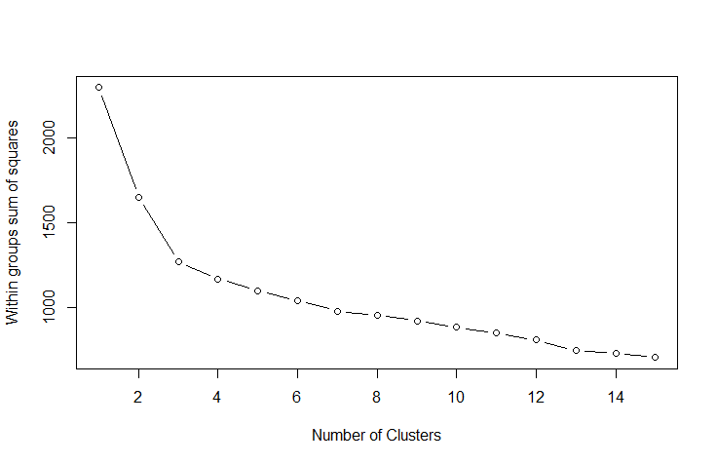
Wssplot Function
df <- scale(wine[-1])
wssplot <- function(data, nc=15, seed=1234){
wss <- (nrow(data)-1)*sum(apply(data,2,var))
for (i in 2:nc){
set.seed(seed)
wss[i] <- sum(kmeans(data, centers=i)$withinss)}
plot(1:nc, wss, type="b", xlab="Number of Clusters",
ylab="Within groups sum of squares")}
wssplot(df)
The plot shows that WSS will decline exponentially with increasing number of clusters
Elbow

Slide 29
NbClust Library – How Many Clusters?
library(NbClust)
set.seed(1234)
nc <- NbClust(df, min.nc=2, max.nc=15, method="kmeans")
*** : The Hubert index is a graphical method of determining the number of clusters.
In the plot of Hubert index, we seek a significant knee that corresponds to a significant increase of the value of the measure i.e. the significant peak in Hubert index second differences plot.
*** : The D index is a graphical method of determining the number of clusters.
In the plot of D index, we seek a significant knee (the significant peak in Dindex second differences plot) that corresponds to a significant increase of the value of the measure.
All 178 observations were used.

Slide 30
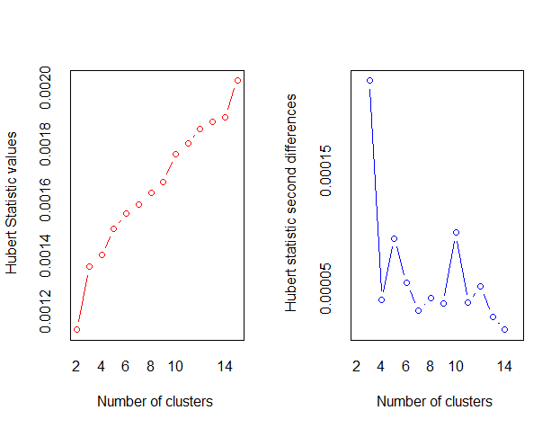
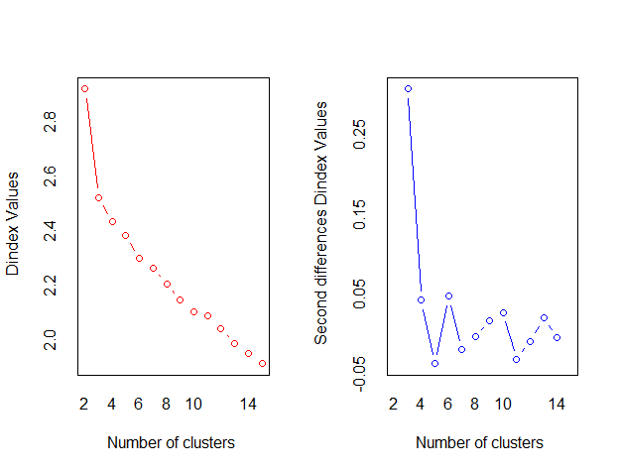
The Hubert index
Knee
Knee

Slide 31
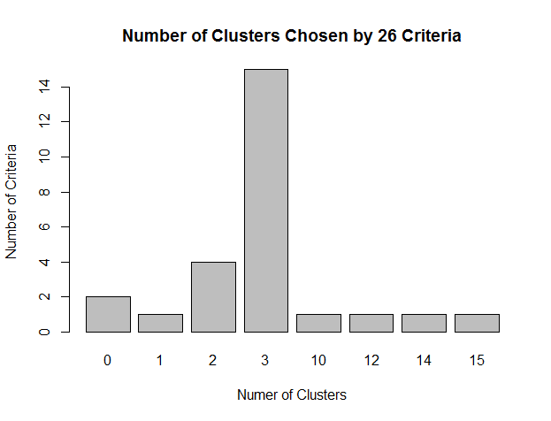
Add a Barplot
Use the barblot to determine the best nc (NbClust value) for the cluster.
table(nc$Best.n[1,])
barplot(table(nc$Best.n[1,]), xlab="Numer of Clusters", ylab="Number of Criteria", main="Number of Clusters Chosen by 26 Criteria")

Slide 32
Fit with kmeans
set.seed(1234)
fit.km <- kmeans(df, 3, nstart=25)
fit.km$size
fit.km$centers
[1] 62 65 51
Alcohol Malic Ash Alcalinity Magnesium Phenols Flavanoids
1 0.8328826 -0.3029551 0.3636801 -0.6084749 0.57596208 0.88274724 0.97506900
2 -0.9234669 -0.3929331 -0.4931257 0.1701220 -0.49032869 -0.07576891 0.02075402
3 0.1644436 0.8690954 0.1863726 0.5228924 -0.07526047 -0.97657548 -1.21182921
Nonflavanoids Proanthocyanins Color Hue Dilution Proline
1 -0.56050853 0.57865427 0.1705823 0.4726504 0.7770551 1.1220202
2 -0.03343924 0.05810161 -0.8993770 0.4605046 0.2700025 -0.7517257
3 0.72402116 -0.77751312 0.9388902 -1.1615122 -1.2887761 -0.4059428

Slide 33
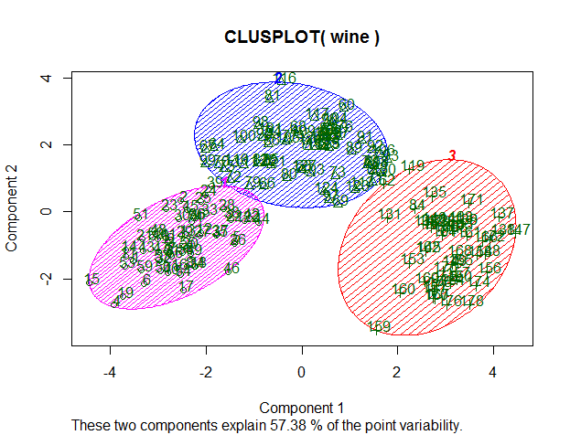
Clustplot
clusplot(wine, fit.km$cluster, color=TRUE, shade=TRUE, labels=2, lines=0)

Slide 34
Clustplot
aggregate(wine[-1], by=list(cluster=fit.km$cluster), mean)
cluster Alcohol Malic Ash Alcalinity Magnesium Phenols Flavanoids
1 1 13.67677 1.997903 2.466290 17.46290 107.96774 2.847581 3.0032258
2 2 12.25092 1.897385 2.231231 20.06308 92.73846 2.247692 2.0500000
3 3 13.13412 3.307255 2.417647 21.24118 98.66667 1.683922 0.8188235
Nonflavanoids Proanthocyanins Color Hue Dilution Proline
1 0.2920968 1.922097 5.453548 1.0654839 3.163387 1100.2258
2 0.3576923 1.624154 2.973077 1.0627077 2.803385 510.1692
3 0.4519608 1.145882 7.234706 0.6919608 1.696667 619.0588

Slide 35
Hierarchical Method Preview
Hierarchical methods use a distance matrix as an input for the clustering algorithm. The choice of an appropriate metric will influence the shape of the clusters, as some elements may be close to one another according to one distance and farther away according to another.
d <- dist(wine, method = "euclidean") # Euclidean distance matrix.
We use the Euclidean distance as an input for the clustering algorithm (Ward’s minimum variance criterion minimizes the total within-cluster variance):
H.fit <- hclust(d, method="ward")
The clustering output can be displayed in a dendrogram
plot(H.fit) # display dendogram
groups <- cutree(H.fit, k=3) # cut tree into 5 clusters
draw dendogram with red borders around the 5 clusters
rect.hclust(H.fit, k=3, border="red")

Slide 36
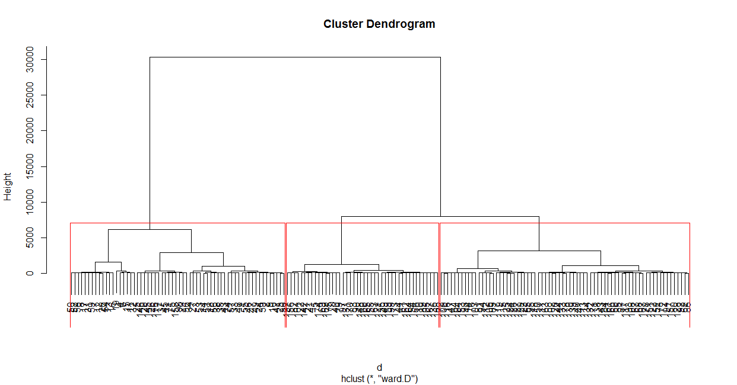

Slide 37
www.humalytica.com
http://www.amazon.com/Jeffrey-Strickland/e/B00IQ69QZK/
http://www.lulu.com/spotlight/strickland_jeffrey

